Slide 1




Object-Oriented Programming: Course Intro
OOP Course Program, Evaluation, Exams, Resources
Svetlin Nakov
Object-Oriented
Technical Trainer
www.nakov.com
Telerik Software Academy
academy.telerik.com

Slide 2

Table of Contents
What's Coming Next in the Academy?
The OOP Course Program
The Trainers Team
Exams and Evaluation
Standard Criteria
Bonuses
Resources for the Course
Champions from C# Part II and CSS Styling

Slide 3

Object-Oriented Programming (OOP)
Coming To The Next Module

Slide 4

What's Coming Next?
Object-Oriented Programming (OOP)
Continuation of C# – Part II
Fundamentals of OOP
Pretty much the same
Lectures two times a week
Practical exam after a month
The course exam?
3-4 problems for 6 hours
Not a test, just a practical exam

Slide 5
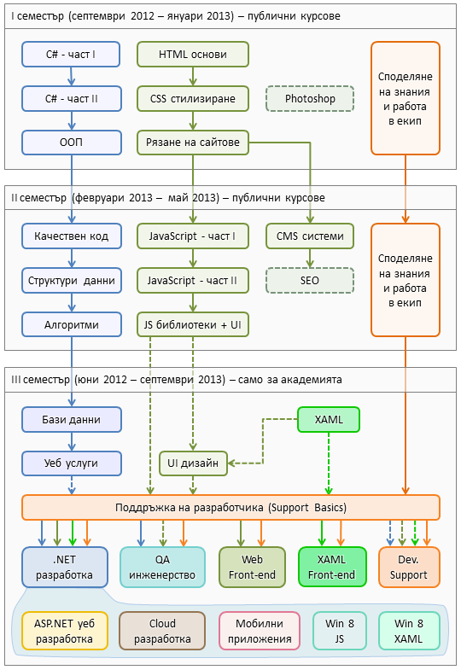
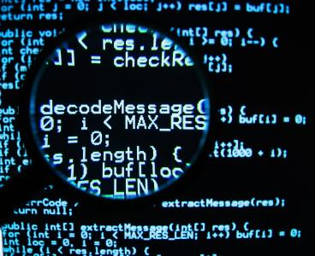
C# Programming Track
Software Academy Curriculum
The C# Programming Track
The Web Front-End Track
Specialties @ the Academy
Success Stories @ Telerik

Slide 6

OOP – Program
What Will We Cover in the OOP Course?

Slide 7



The OOP Course Program
OOP Course Intro
Course Program, Exams, Evaluation
Defining Classes – Part I
Classes, Fields, Constructors, Methods, Properties, Enums
Defining Classes – Part II
Static Members, Structures, Generic Types, Namespaces, Attributes
Delegates, Extension Methods, Lambda Functions, Anonymous Types and LINQ

Slide 8



The OOP Course Program (2)
OOP Fundamental Principles – Part I
Inheritance, Abstraction, Encapsulation
OOP Fundamental Principles – Part II
Polymorphism, Real-World Class Hierarchies, Cohesion and Coupling, UML Class Diagrams
.NET Common Type System
Value and Reference Types, System Interfaces, Cloning, Comparison, Enumeration
OOP Workshop: Creating a Game
Exam Preparation

Slide 9

The Trainers Team

Slide 10
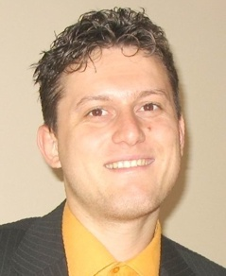
Trainers Team
Svetlin Nakov, PhD
Manager Technical Training @ Telerik Software Academy
20 years software development experience
10+ years experience as trainer
Author of 6 books
Speaker at hundreds of events
E-mail: svetlin.nakov [at] telerik.com
Web site / Blog: http://nakov.com

Slide 11
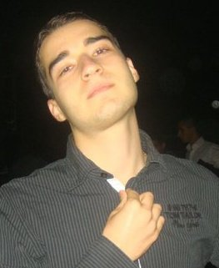
Trainers Team (2)
Nikolay Kostov
Team Lead, Senior Developer and Trainer @ Telerik Corp.
Student in Sofia University
Computer Science
IT and Informatics competitions contestant
Graduate from the second season of Telerik Software Academy
Email: nikolay.kostov [at] telerik.com
Blog: http://nikolay.it

Slide 12
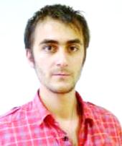
Trainers Team (3)
Doncho Minkov
Technical Trainer @ Telerik Software Academy
Student in Sofia University
Software Engineering
Contestant in the Informatics competitions
Graduate from the first season of Telerik Software Academy
Email: doncho.minkov [at] telerik.com
Blog: http://minkov.it

Slide 13
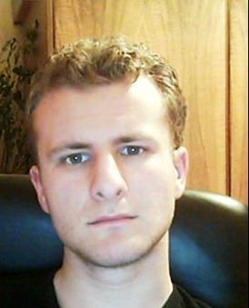
Trainers Team (4)
George Georgiev
Technical Trainer @ Telerik Corp.
Informatics and IT competitions contestant and winner
Student in Sofia University
Software engineering
Graduate from the third season of Telerik Software Academy
E-mail: georgi.georgiev [at] telerik.com
Blog: http://itgeorge.net

Slide 14





Evaluation
Thank God There Are Bonuses!

Slide 15

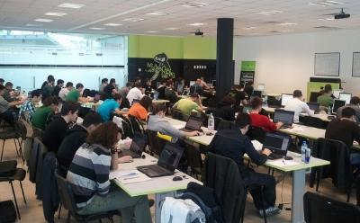
OOP – Evaluation
Evaluation components
Practical exam – 65%
Teamwork – 15%
Homework – 10%
Homework evaluation – 10%
3 peer reviews per homework
Bonuses
Helping new students – bonus up to 15%
Forums activity – bonus up to 10%

Slide 16
Homework Peer Reviews
Everyone will get feedback for their homework
Everyone will give feedback for few random homework submissions
Students submit homework anonymously
Please exclude your name from the submissions!
For each homework submitted
Students evaluate 3 random homeworks
From the same topic, after the deadline
Give written feedback, at least 200 characters
Low-quality feedback → report for punishment

Slide 17








Resources
What We Need in Addition to this Course Content?

Slide 18

The C# Textbook
The official textbook for the course
“Introduction to Programming with C#”, Nakov S. and his team, 2010
Freely downloadable from: www.introprogramming.info
The C# programming tracks follows the book
OOP → chapters 11, 14, 20 and 22

Slide 19
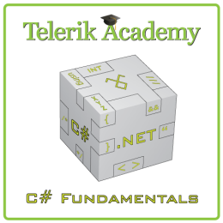
Course Web Site & Forums
Register for the "Telerik Academy Forums":
Discuss the course exercises with your colleagues
Find solutions for the exercises
Share source code / discuss ideas
The C# Part II official web site:
http://forums.academy.telerik.com/csharp-programming/csharp-oop
http://academy.telerik.com/student-courses/ programming/object-oriented-programming/

Slide 20
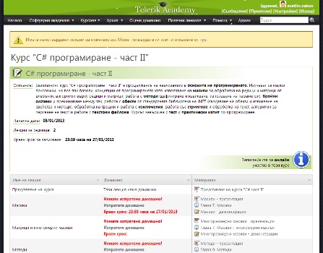
Telerik Integrated Learning System (TILS)
The Telerik Integrated Learning System (TILS)
www.telerikacademy.com
Important resource for all students
Homework submissions
Homework peer reviews
Presence cards with barcode
Reports about your results
telerikacademy.com/Courses/Courses/Details/114

Slide 21


Required Software
Software needed for this course:
Microsoft Windows (XP / Win7 / Win8)
Microsoft Visual Studio 2012 or Visual Studio Express 2012 (free version of VS 2012)
.NET Framework 4.5 (included in Visual Studio)
Visual Studio2008, 2010 or 2013 is also OK

Slide 22
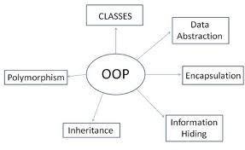
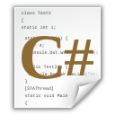


Object-Oriented Programming: Course Introduction
http://academy.telerik.com

Slide 23
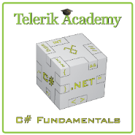



Free Trainings @ Telerik Academy
C# Programming @ Telerik Academy
csharpfundamentals.telerik.com
Telerik Software Academy
academy.telerik.com
Telerik Academy @ Facebook
facebook.com/TelerikAcademy
Telerik Software Academy Forums
forums.academy.telerik.com

